Slide 1

NLP and Word Embeddings
GloVe word vectors
deeplearning.ai

Slide 2
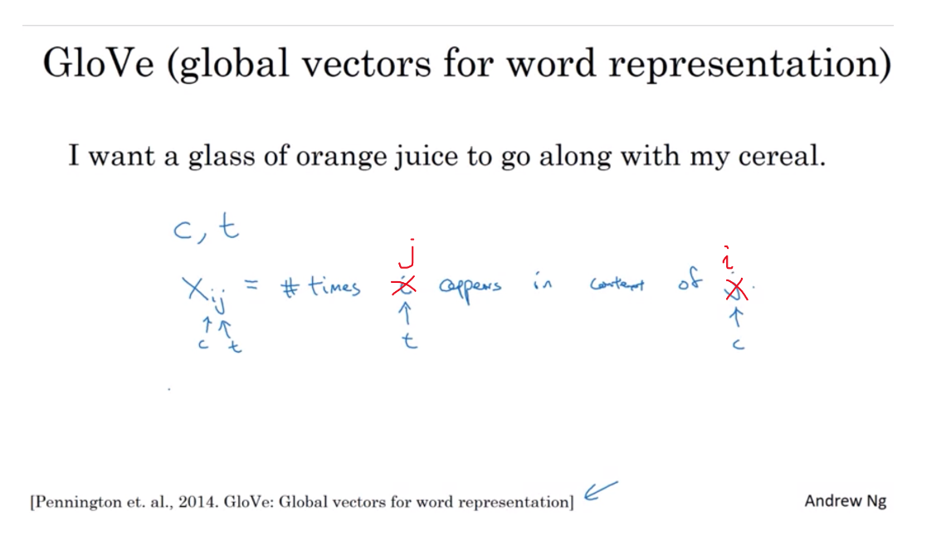

Slide 3
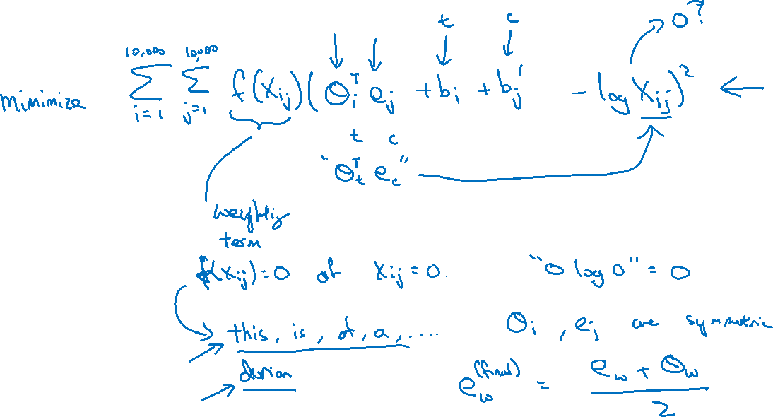
Model

Slide 4
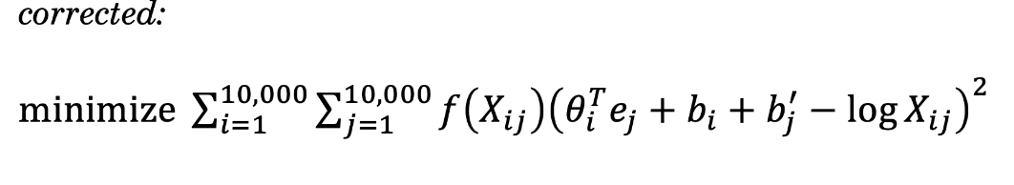





A note on the featurization view of word embeddings
Man
(5391)
Woman
(9853)
King
(4914)
Queen
(7157)
Gender
$$−1$$
1
-0.95
$$0.97$$
Royal
$$0.01$$
0.02
0.93
$$0.95$$
Age
0.03
0.02
0.70
0.69
Food
0.09
0.01
0.02
0.01
m$inimize \sum_{i=1}^{10,000}{\sum_{j=1}^{10,000}{f\left(X_{ij}\right){\left(θ_{i}^{T}e_{j}+b_{i}−b_{j}^{′}−\log{X_{ij}}\right)}^{2}}}$

